Slide 1
HANGMAN
A fresh take
Notes:
-User word constraints – what if the user enters a proper name as the clue word
-As the clue, maybe give the user word ONLY at first, and then include a button to give a definition as the clue
-If the user enters more than one letter as a guess, don’t allow that
-An easy and hard difficulty with a different number of guesses
-How will I draw the hangman? 20 different images with the body at a different stage
-Include date, and slide numbers in the ppt.
-Include a works-cited in the ppt.

Slide 2
What am I doing?
This project is a modified version of the game Hangman.
At the beginning of the game, the user is asked what word he would like to be included in the definition of the word he will be guessing.
Of the words that have the user word in the definition, a random word would be selected from an English dictionary database.

Slide 3
What am I doing?
There would be an input box, where the player would input letters, and a button to submit a letter.
A list of the letters already tried would be displayed.
When the player makes his first mistake, the stand where the body will hang if you lose the game would appear, as would the head of the stick-figure man.
With every subsequent mistake, an additional body part would appear.
The game would end when the player completed the word (victory), or the body was completed (loss).

Slide 4
Goals
Set-up an intuitive graphical user interface (GUI) that allows the user to play the game
Interact with an English dictionary database to feed words and definitions for the game. Also to be used to search for eligible words given the user input
Ensure that the game does justice to the original Hangman by containing all the components of the original game (with the additions that were aforementioned)

Slide 5
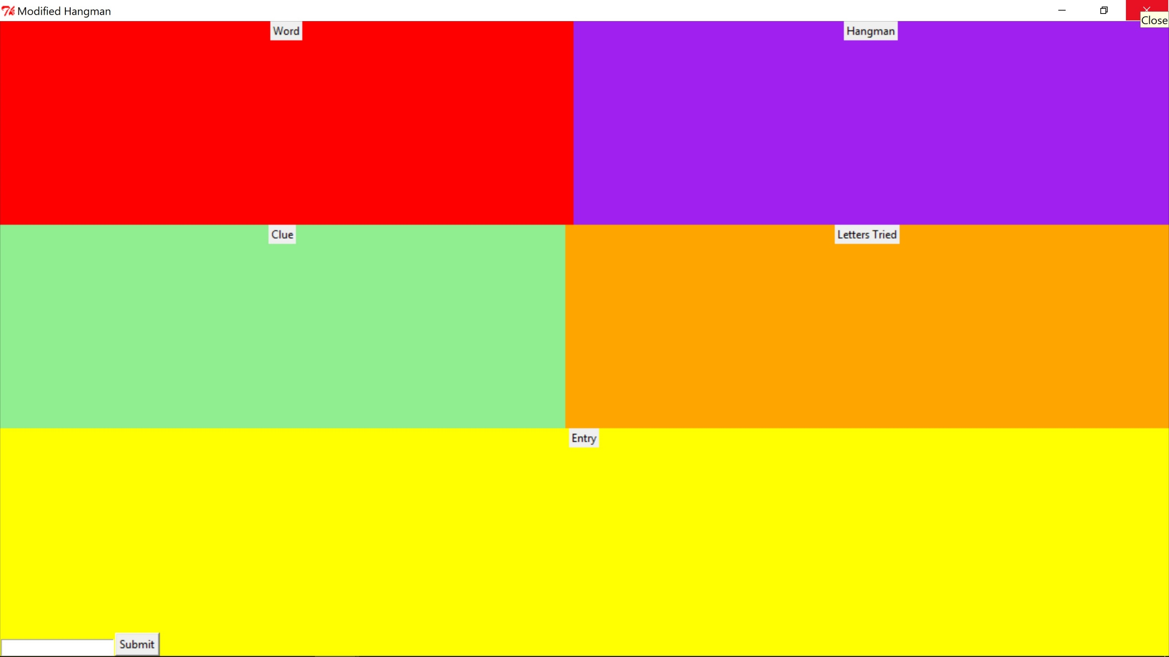
The Graphical User Interface (GUI)
This is what my GUI currently looks like, with each color representing a frame that is holding a place for something to be included in the game.
The frame labels serve as reminders for what will be where

Slide 6
Data…Data…Data….
The data will be obtained from an English dictionary database. The different sets of data to be obtained are:
Words in the English language
Definitions of these words
Will also be used in the search component for comparison with the user-inputted word that he/she would like to be included in the definition of the word to be guessed

Slide 7
How Will The Code Interact?
Tkinter to write GUI elements in Python
By importing this module, I was able to create the GUI elements shown previously
Provides a creatable set of widgets, including frames, labels, buttons, radio-buttons, etc.
Sqlite3 to interact with the dictionary database
Can be imported into Python as well
Allows for database manipulation
Database obtained online

Slide 8
Tools to be used/Miscellaneous
I have encountered difficulties in GUI widget positioning within a frame, and there may be further issues in the future
May be able to solve my problems by using padx and pady, depending on the situation
I foresee having trouble implementing certain visual elements in the way I would like, such as the display of letters of the word that is being guessed
I have had trouble opening the obtained database. Hopefully the issue will not reappear in the future
Online documentation and tutorials on Tkinter, SQLite3 and Python in general, have been a big help

